Slide 1
Fuel Poverty Toolkit
Una Porteous ARC Healthy Living Centre

Slide 2
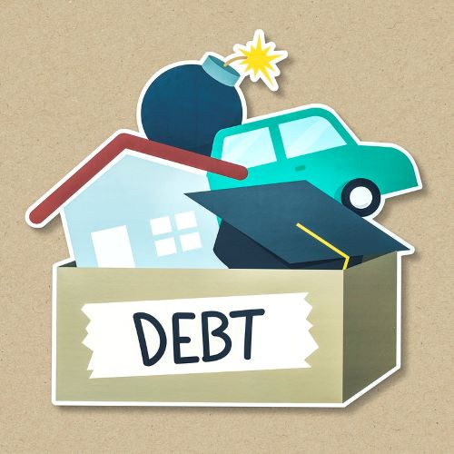
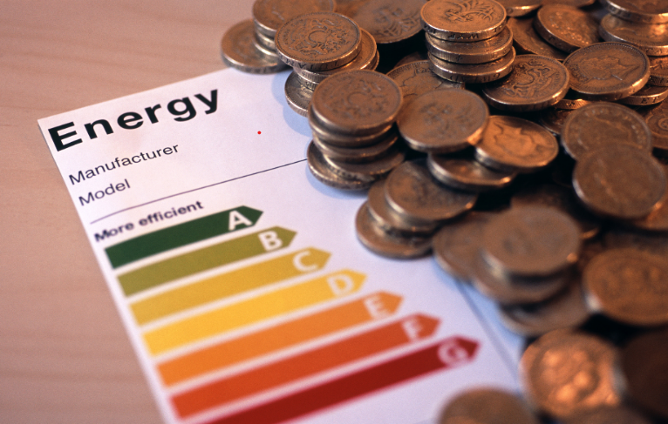
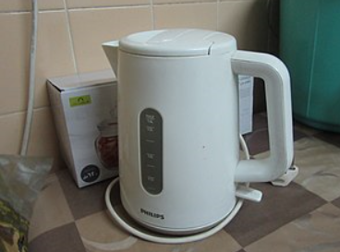

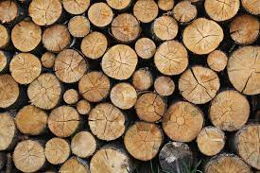

Slide 3
Purpose - this toolkit is designed to support those either in or at risk of Fuel Poverty
In his report on the Health Impacts of Cold Homes and Fuel Poverty in 2011 Professor Michael Marmot referenced the fact that fuel poverty is a long standing health issue.
This has not changed in the past 10 years
Fuel poverty continues to contribute to social and health inequalities and the FACT remains that it is avoidable

Slide 4
Who is our audience?
Our aim is to target those people in the health sector, local authorities and third sector partners, so that there can be a combined effort made for collaborative working focussing efforts to remove this issue from our areas
There is a need for those working in this field to have a heightened awareness of the indicators of this problem
This should arm them with the confidence to know when, where and how to refer people in this position and to be confident that action can be taken and that this action will improve people’s lived experience and exposure to the risk of harm from their living environment

Slide 5
What is Fuel Poverty?
Widely recognised that the UK has well established definitions of Fuel Poverty/Energy Poverty – 1990s, Boardman definition was largely accepted – where a household is required to spend more than 10% of income on energy costs
In 2012 the Hills review caused England to revise its definition – moving to a Low Income High Cost definition – fuel costs higher than the median level and where the remaining household income after paying fuel costs left the household with an income below the poverty level. This definition has been reviewed and is now Low Income Low Energy Efficiency (LILEE) making reference to the Energy Efficiency Rating of the home and the disposable income of the household
The Hills review also identified the fuel poverty gap – effectively identifying the severity and depth of fuel poverty.

Slide 6
What is Fuel Poverty?
The other nations of the UK – Scotland, Wales and Northern Ireland have accepted divergent definitions with Wales and Northern Ireland accepting that households need to be paying more than 10% of income on fuel costs in order to maintain a satisfactory heating regime – temperature of 18-21°C to be defined as being in fuel poverty. Wales have also identified severe fuel poverty (more than 20% of household income being spent on fuel costs) and those at risk of fuel poverty (>8% but <10%)
Whilst Scotland retain the 10% definition, there are adjustments made taking account of housing costs, and for childcare, disability and care costs
It remains the case that there is limited evidence of formal definitions for fuel poverty in EU and NPA countries beyond the UK –although at the time of writing there are some plans for this to change – namely in the Netherlands and at a supranational EU level – interestingly the move is to make the definition multi-factorial- taking into account a range of indicators – extending to health, building stock, and energy prices

Slide 7
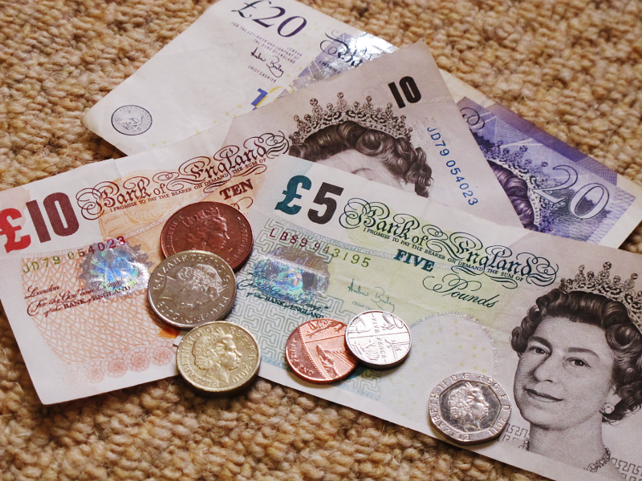
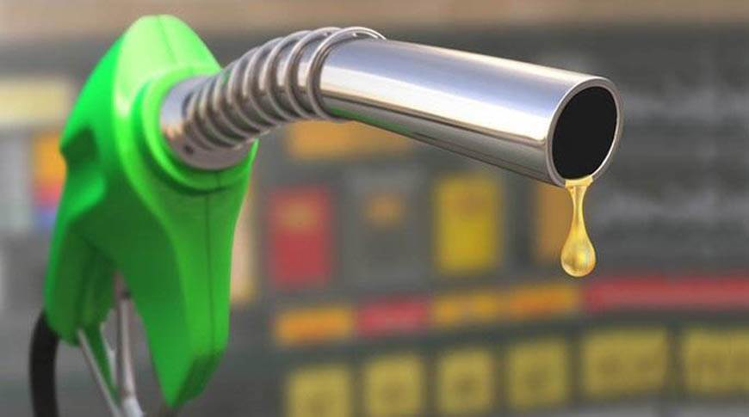

What is Fuel Poverty?
Acceptance that the issue of Fuel Poverty is the product of a number of factors – Low Income, Poor Energy Efficiency and High Fuel Costs

Slide 8

How does a Cold Home affect its residents?

Slide 9
What are the Risks of Living in a Cold Home?
Universal recognition that living in a cold home has a negative impact on the health and well-being of the occupants
Increases the health inequalities of the residents
Risks avoidable health exacerbations – respiratory problems, circulatory and cardiovascular problems, mental health difficulties,
Increases to Excess Winter Deaths – around 1/3 of these are caused by respiratory illnesses – with a strong link between cold homes and lower resistance to respiratory infections
Public Health England indicate that GP consultations in older people increase by 19% for every 1°C drop in temperature below 5°C (external temperature)

Slide 10
What are the Risks of Living in a Cold Home?
Risks to children’s health – more than twice as likely to suffer from respiratory illnesses compared to children living in warm homes
Increased risk of falls and accidental injuries to the elderly as a result of exacerbations of arthritis decreasing dexterity and declining strength
Indirect effects include carbon monoxide poisoning, poorer educational outcomes amongst others
Social isolation can be a side effect, as people are disinclined to bring friends into a cold home
Indications that living in a cold home can impact on mental health/anxiety – often caused about concern about fuel costs and debt

Slide 11
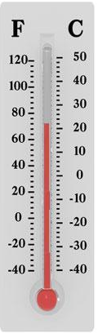
What is a Healthy Home Temperature
18-24ºC Minimal risk to sedentary persons, wearing suitable clothing
Below 16⁰C Lower resistance to respiratory infections
Below 12⁰C Raised blood pressure
Below 9⁰C After 2 or more hours, deep body
temperature falls, blood pressure rises, increased risk of cardiovascular disease
Below 6ºC Significant risk of hypothermia

Slide 12
Healthy Temperature for a Home
This is somewhat dependent on the residents of the home - 18°C poses little risk to a sedentary resident suitably dressed.
18°C- 21°C is generally recommended for living areas with 18°C recommended for most rooms

Slide 13
Do Policy Drivers work to Support Cold Homes?
England has the 2015 Fuel Poverty Strategy which sets a target for the reduction of Fuel Poverty to ensure a reduction in those facing this issue
Target set to ensure that as many fuel poor homes ‘as is reasonably practicable’ achieve an energy rating of Band C by 2030
NI is currently still consulting on the new Fuel Poverty Strategy – it is becoming clear that the issue of Fuel Poverty is multi-dimensional and complex- with implications for health and well-being, wider debt problems and access to wider energy services
Implications for rural communities are complex –options are limited for many rural dwellers who have less choice than urban dwellers

Slide 14
Policy Drivers
Primarily those regions that identify Energy Poverty as an issue, endeavour to address it via a range of methods and policy is one of the predominant means.
Routinely, policies establish a target for the reduction of Energy Poverty – England’s Fuel Poverty Strategy of 2015 established a target of ensuring that as many fuel poor homes ‘as is reasonably practicable’ should achieve an energy efficiency rating of Band C by 2030. This is punctuated by milestones along the way.
Government has placed an obligation on large energy supplier – the Energy Company Obligation – whereby the suppliers are required to reduce their own energy consumption and support those living in fuel poverty – this represents two aspects
Carbon Emissions Reduction Obligation (CERO) – suppliers need to promote primary measures including roof and wall insulation
Home Heating Cost Reduction Obligation – need to recognise customers who may be vulnerable to fuel poverty and promote measures that will encourage heat savings

Slide 15
Policy Drivers
Local authorities can mandate certain households as meeting eligibility criteria for certain measures against energy poverty e.g. Affordable Warmth
New Decade , New Approach set out ambitions within Northern Ireland to deliver on commitments on the Climate Change Act and a New Green Deal – although ensuring that this is achieved equitably remains a challenge.
The Programme for Government released for consultation in January 2021 contains an aspiration to ensure that ‘our community is globally competitive, regionally balanced and carbon-neutral’. The implementation of energy efficiency measures which will reduce energy demand will be a central tenet of achieving this ambition.
Policy measures will go so far – but need to encourage behavioural change in us all in order to be effective

Slide 16
Policy Drivers
Building regulations provide an opportunity for influencing approaches to Energy Efficiency – currently Future Home Standards in England should be aligned to ensure that new build properties are future-proofed
NI have committed to reviewing Building Regulations – subject to usual policy development and consultation processes

Slide 17
What can I do to help myself if I live in a Cold Home?

Slide 18
Energy Efficiency
Energy efficiency is central to all energy transition pathways to achieve net zero, as reduced energy demand decreases the need for energy network upgrades and ensures energy bills are affordable. (HECA 2020 report)

Slide 19
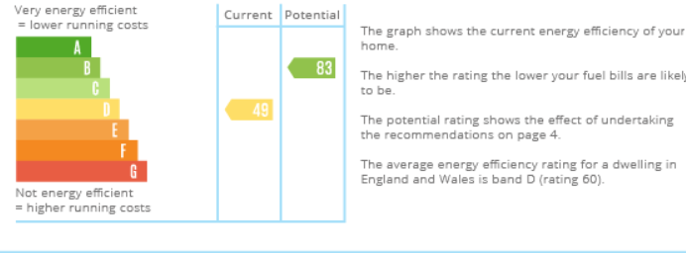
Energy Performance Ratings

Slide 20
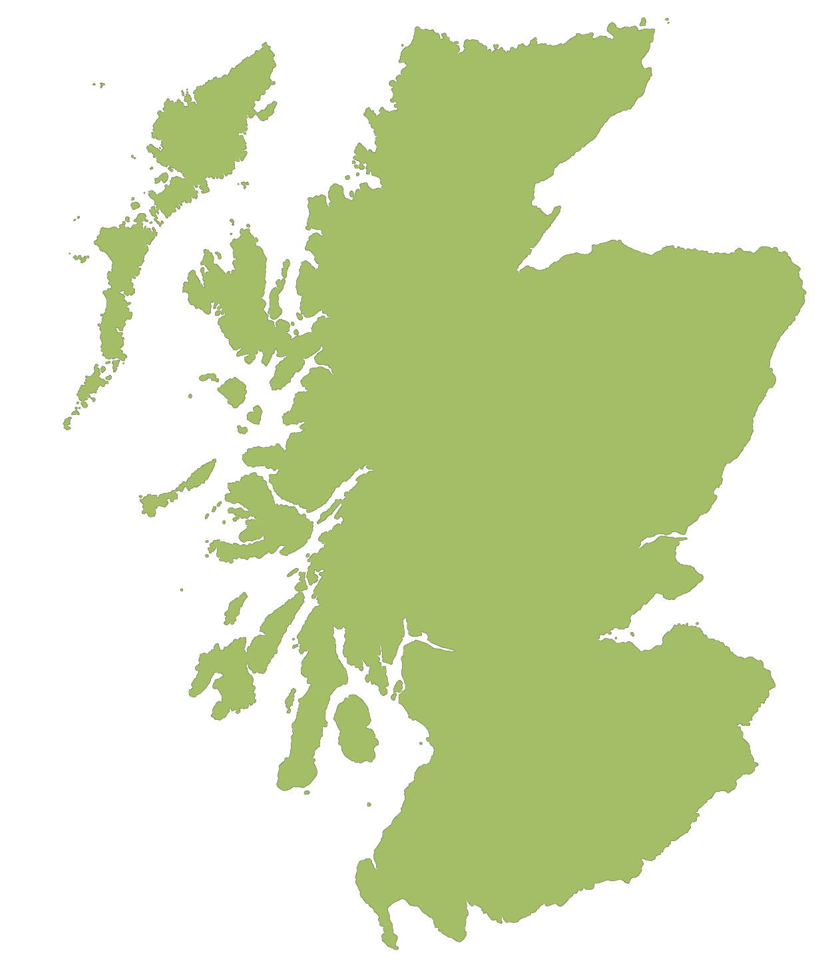

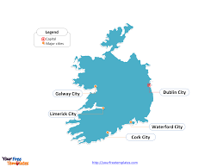
What are the Referral Pathways for Cold Homes?
There are clear distinctions in the referral pathways for those parts of the region that are impacted by energy poverty
Our analysis of the countries within the NPA region indicate that in relation to energy poverty definition, strategy and the role of rurality in these areas, there are no identified pathways for Finland, Sweden, Greenland, Faroe Islands, Iceland or Norway.
Within the United Kingdom and Ireland there are distinct pathways

Slide 21
Scotland
Scotland ‘Fuel Poverty (Targets, Definition and Strategy)(Scotland) Act 2019
Scottish Fuel Poverty Advisory Panel – established April 2018 – provide government with feedback on progress in meeting targets.
The Home Energy Efficiency Programmes for Scotland (HEEPS) – this is a suite of supports offered through Energy Advice Scotland and accessible via https://www.eas.org.uk/en/home-energy-efficiency-programmes-for-scotland-heeps
Supports include
  Area Based Schemes (ABS)
  Warmer Homes Scotland
  Home Energy Scotland Loan Scheme
  Equity Loan Pilot Scheme
Warmer Homes Scotland
  https://www.homeenergyscotland.org/find-funding-grants-and-loans/warmer-homes-scotland

Slide 22
Scotland
Scottish government also recognise the link between fuel poverty and health inequalities and their draft strategy on Fuel Poverty and the Fuel Poverty Bill are backed up by a Health Impact Assessment. This enables the evidence and details of the effects of living in cold damp homes to be measured and in partnership with NHS Scotland should work towards reducing these impacts and inequalities.
There are also clear linkages with improving energy efficiency and meeting climate change commitments, whilst recognising the need to do this in a fair and equitable way – utilising job creation opportunities and new technology developments in a creative way.
There is a strong awareness within Scotland of the need for transitions to cleaner energy sector to keep affordability central to the process

Slide 23
Northern Ireland
https://www.nihe.gov.uk/Housing-Help - schemes and grants
NI Energy Advice Service – 0800 111 4455 or GET-IN-Touch e-form on NIHE website
Energy Efficiency Interventions include
  Affordable Warmth Scheme
  Boiler Replacement Services
Northern Ireland Sustainable Energy Programme – funded by a levy on customer utility bills – this support aims to fill the gap where customers not eligible for the above grants may seek assistance
Given that 68% of households use home heating oil – Oil Buying Clubs remain a support for many. Details available from Housing Executive

Slide 24
Ireland
Contained within ‘A Strategy to Combat Energy Poverty 2016-2019’
National Retrofit Programme Community Energy Grant 2021 https://www.seai.ie/grants/home-energy-grants
The measures available include support for a wide range of interventions covering
  Insulation
  Heat Pumps
  Heating Controls
  Solar Water Heating
  Solar Electricity
Details with value of each intervention are available through the above link

Slide 25
Low Carbon Technologies
Northern Ireland continues to have a high level of dependence on Home Heating Oil (68% households)
Natural Gas network is strongly focussed on the eastern side of the province – although Gas to the West will impact on this somewhat- rural dispersed communities will remain ‘off-network’ – natural gas is a lower carbon fuel rather than low carbon.
There is the possibility of the use of green hydrogen as a replacement for natural gas within the existing network and trials in this are being closely monitored
Handiheat pilots have examined the potential of a mixed portfolio of low carbon technologies and the data collected in these pilots will be evaluated to inform future decision making

